Slide 1

GirlCode Hackathon Presentation
Team Name: 7/11
Team Members: Zwavhudi Mulelu and Nqobile Mhlanga
Date: 02 August 2020

Slide 2
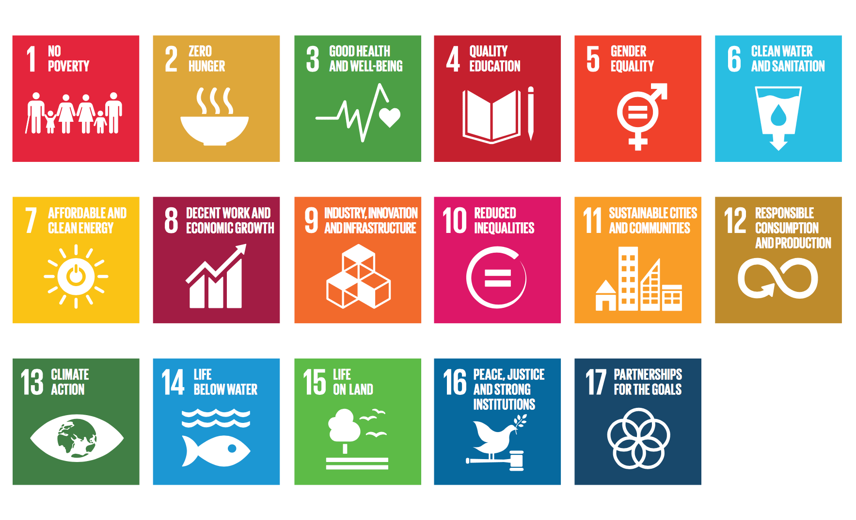
Chosen UN Sustainable Development Goals
GOAL 11: Sustainable Cities and Communities
GOAL 12: Responsible Consumption and Production

Slide 3
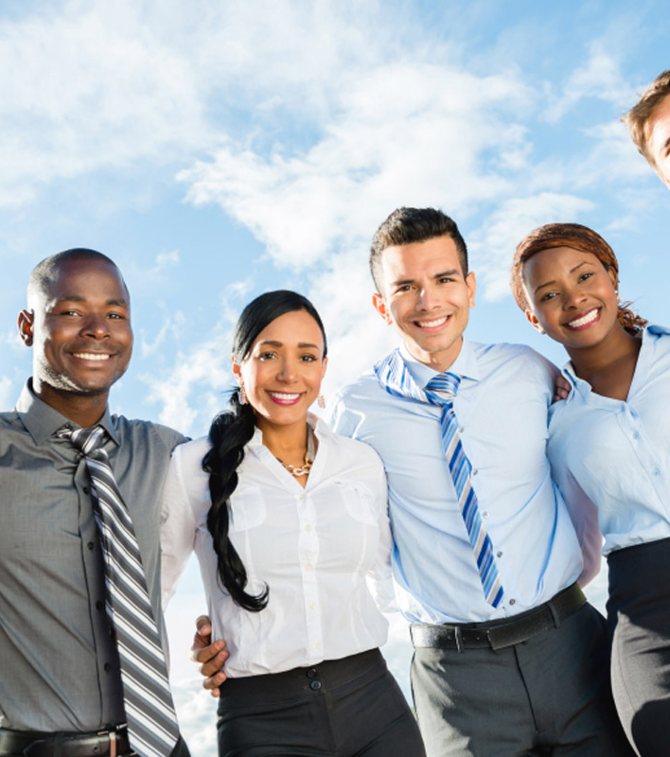
Problem Statement
Young people/young professionals
Affordable place to live in

Slide 4
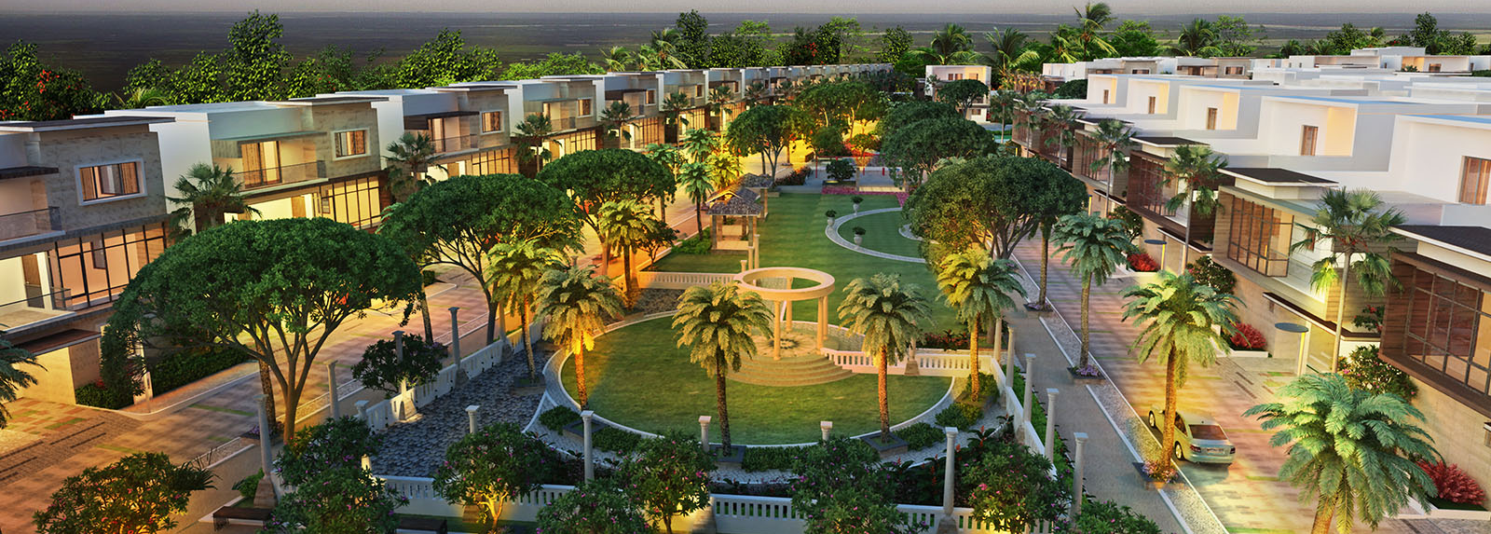
Solution
Sustainable Gated Community

Slide 5
Demo

